Slide 1


B.Tech CSE Project
Exploratory Data Analysis (EDA) on Netflix Movies and TV Shows Dataset

Slide 2

Key Points on EDA
Definition:
Exploratory Data Analysis (EDA) is the process of understanding, cleaning, and visualizing data before modeling or decision-making.
Purpose:
To discover patterns, trends, and relationships in data.
To detect outliers, missing values, or data inconsistencies.
To summarize key characteristics using statistics and visuals.
Main Steps:
Data collection and loading
Data cleaning (handling missing or duplicate values)
Feature engineering (creating new useful features)
Data Analyzation.
Data visualization (plots, charts, heatmaps, etc.)
Tools & Libraries Used:
Python: pandas, numpy, matplotlib, seaborn
Jupyter Notebook: for interactive data analysis and visualization
Outcome:
EDA provides meaningful insights that guide further analysis, modeling, or business decisions

Slide 3





Presentation Agenda
Overview of key topics in our analysis
Objective: Analyzing content trends on Netflix
Dataset Overview: Understanding the collected data
Libraries Used: Tools for data analysis and visualization
Data Cleaning: Preparing data for analysis
3

Slide 4

Project Objective
Analyzing Netflix Data Trends and Patterns
The aim of this project is to conduct a thorough analysis of Netflix data, uncovering significant relationships and patterns that inform trends in viewer preferences and content performance.
USE OF EDA (EXPLORATORY DATA ANALYSIS)
UNDERSTAND DATA
Helps you understand the structure, patterns, and distribution of the data.
2.IDENTIFY OUTLIERS & ERRORS
Detects unusual values, missing data, and incorrect entries.
3.FIND RELATIONSHIPS
Shows how different variables relate to each other (correlation, trends).
4.GUIDE FEATURE SELECTION
Helps decide which features are important for modeling.
5.SHAPE BUSINESS INSIGHTS
Reveals useful insights for decision-making.
6.IMPROVE MODEL PERFORMANCE
Ensures better model accuracy by cleaning and understanding data.
7.CHOOSE RIGHT VISUALIZATIONS & MODELS
Helps decide suitable charts and machine learning algorithms.
4

Slide 5
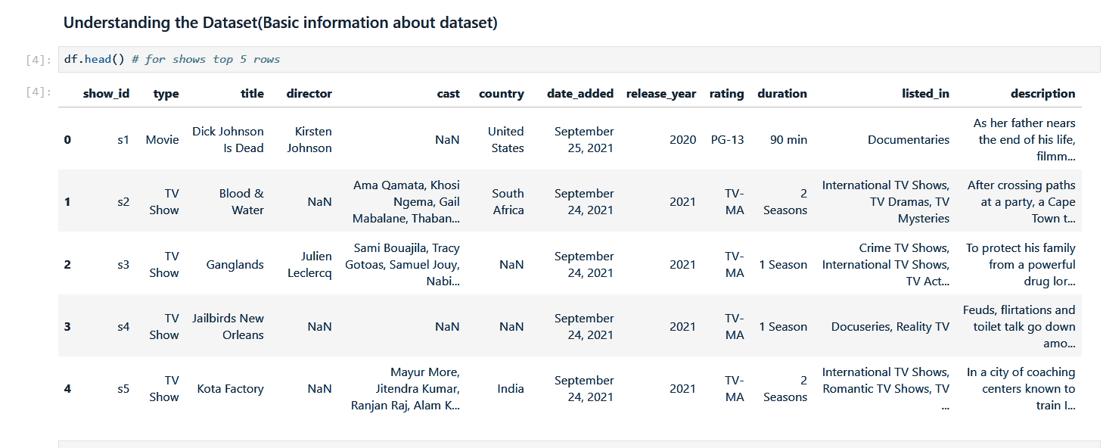

Overview of Netflix Dataset
Dataset
A comprehensive collection of Netflix titles.
This dataset contains 8807 rows and 12 columns.
5

Slide 6




Libraries Used
Essential Python libraries for data analysis
Pandas : Data cleaning, handling, and manipulation
NumPy : Numerical operations
Matplotlib : Basic plotting and visualization
Seaborn : Advanced & beautiful visualizations
6

Slide 7

Data Cleaning
Addressing Missing Data and Duplicates
Effective data cleaning ensures accurate analysis. This includes identifying and removing duplicates, as well as imputing missing values to maintain dataset integrity for reliable insights.
Handle missing values (drop or fill)
Convert “Date Added” to datetime format
Extract “year” and “month” from date
Fill null values
7

Slide 8




Code Explanation -
Data Loading
Initial Inspection
This step involves importing the dataset for analysis.
Here, we check the dataset's structure and integrity.
df = pd.read_csv("netflix_titles.csv")
df.info() → check datatypes
df.isnull().sum() → find missing values
df.describe() → summary stats
df.nunique() → unique counts
8

Slide 9
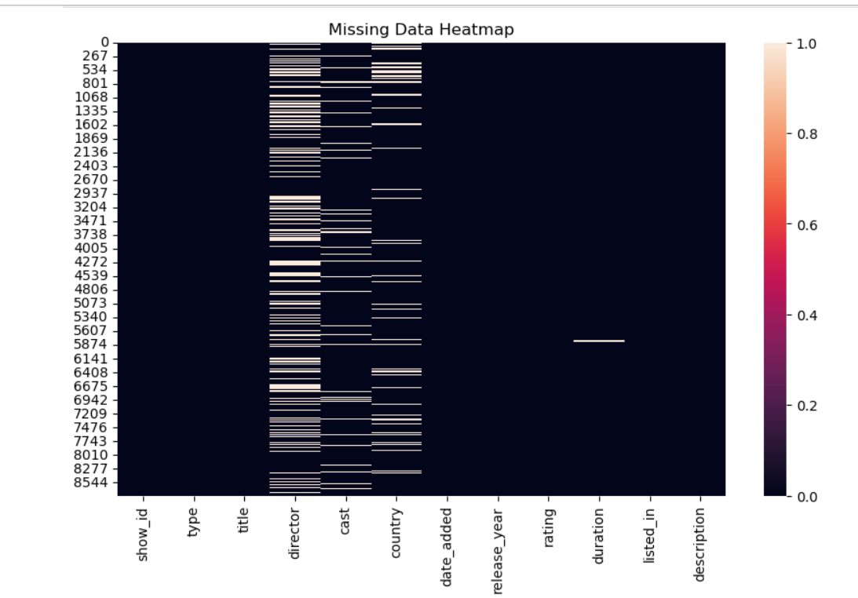

Code Transformation
Feature Engineering
New features are created to enhance analysis and insights.
Convert “Date Added” to datetime → changes raw text into a usable date format.
Extract “Year” and “Month” → creates two new useful features for trend analysis.
Splitting “listed_in” into genres → helps analyze genre frequency.
Handling missing values → ensures data consistency.
Heatmap — Missing Data Visualization
9

Slide 10
Insights
Key Findings from Data Analysis
Count of Movies vs TV Shows
What are the different rating defined by Netflix
Finding the best Month for releasing content
Top 10 countries producing most titles
Trend of content production over years
Common ratings and genres (listed_in)
Which directors or actors appear most
10

Slide 11
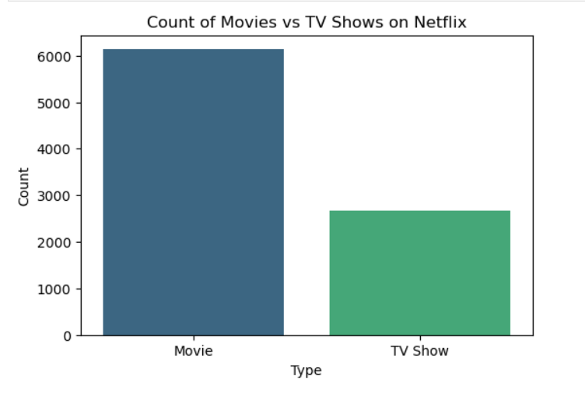
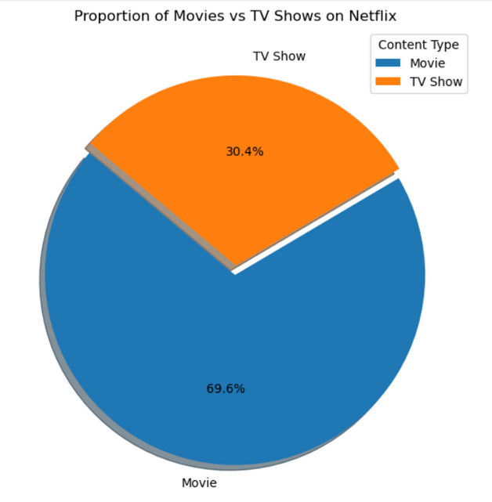
Data Analysis
OBSERVATION
RESULTS:
Count of Movies vs TV Shows
MOVIES ARE BEING WATCHED MORE THAN TV SHOWS.
NETFLIX HAS A SIGNIFICANTLY HIGHER NUMBER OF MOVIES COMPARED TO TV SHOWS, INDICATING ITS PRIMARY FOCUS ON FILM CONTENT.
HOWEVER, TV SHOWS HAVE BEEN RISING STEADILY, REFLECTING NETFLIX’S GROWING INVESTMENT IN LONG-FORM SERIES.
COUNT PLOT
PIE CHART

Slide 12
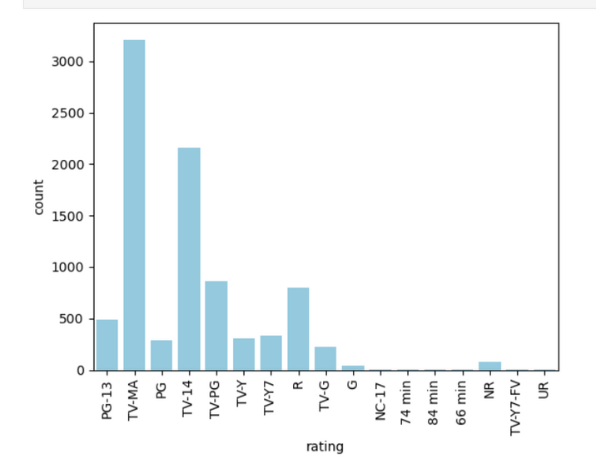
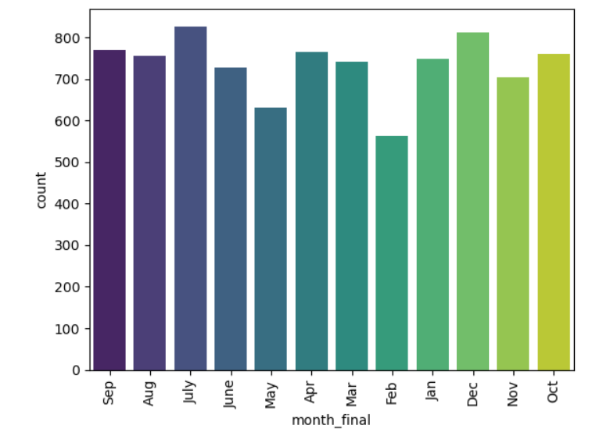
COUNT PLOT
COUNT PLOT
What are the different rating defined by Netflix
Finding the best Month for releasing content
OBSERVATION
OBSERVATION
Audience prefers mostly TV-MA & TV-14 and less prefers NC-17 as rating.
There are 17 types of ratings in the netflix.
Its clearly shows that July month has maximum number of movies released.
July is the best Month for releasing content.

Slide 13
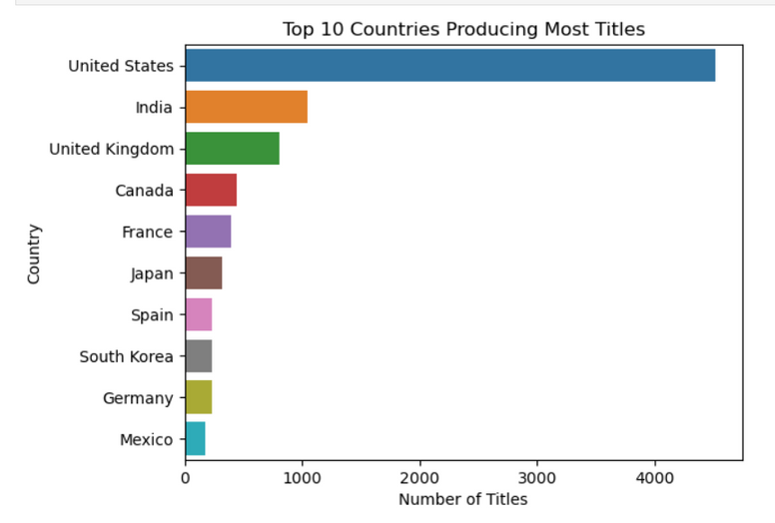
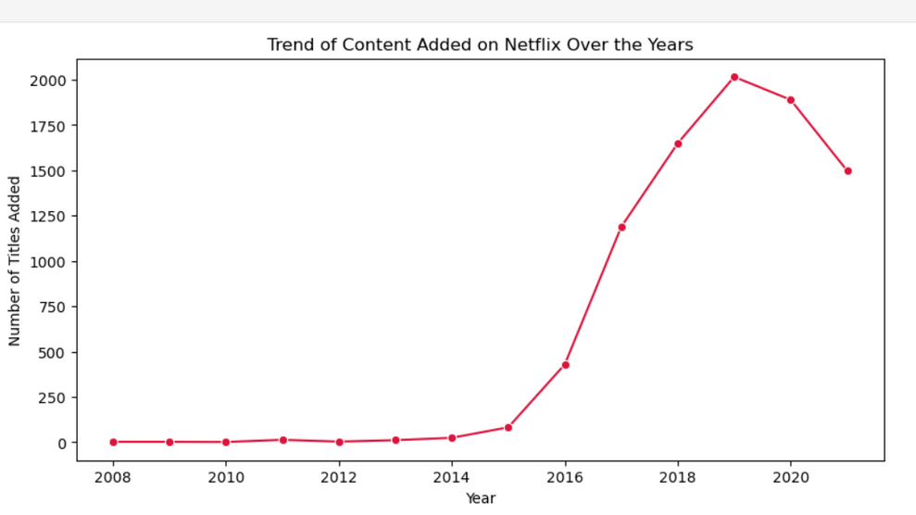
BAR PLOT
LINE PLOT
Top 10 Countries Producing Most Titles
Trend of Content Production Over Years
OBSERVATION
OBSERVATION
The United States leads in content production, followed by India and the UK.
Netflix sources content globally to attract audiences from different regions.
Netflix content shows a sharp rise after 2015, reflecting global expansion and originals.
A slight slowdown after 2020 suggests production delays and market saturation.

Slide 14
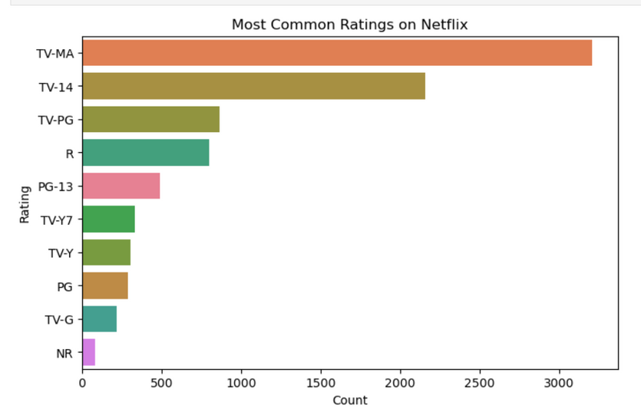
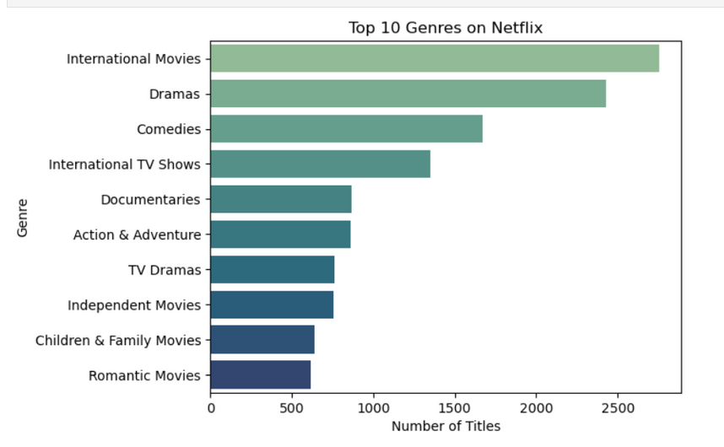
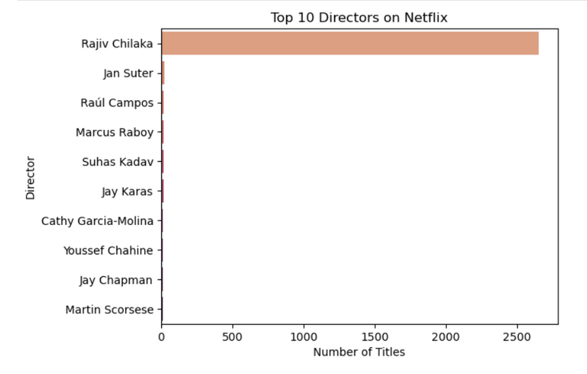
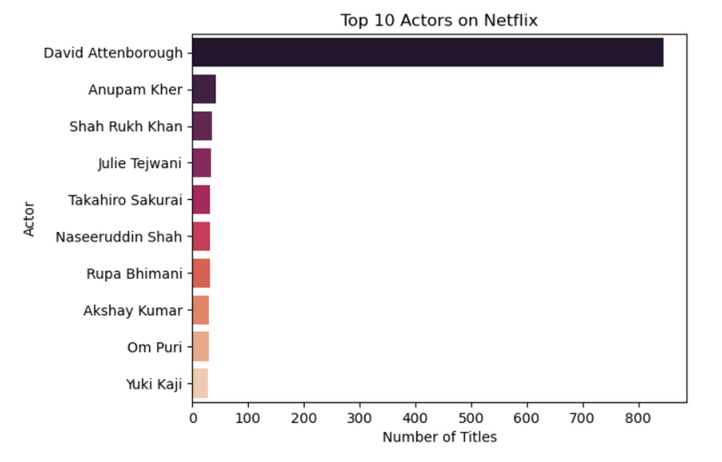
MOST COMMON RATINGS ARE TV-MA AND TV-14.
MOST COMMON GENRES WACHED BY PEOPLE ARE INTERNATIONAL MOVIES, DRAMAS, COMEDIES AND INTERNATIONAL TV SHOWS.
COMMON RATINGS
Genres (listed_in):
WHICH DIRECTORS APPEAR MOST
WHICH ACTORS APPEAR MOST
THE DIRECTOR WHOSE WORK IS WATCHED BY PEOPLE MOSTLY IS RAJIV CHILAKA.
MOST POPULAR ACTORS ARE DAVID ATTENBOROUGH,ANUPAM KHER AND SHAH RUKH KHAN.

Slide 15
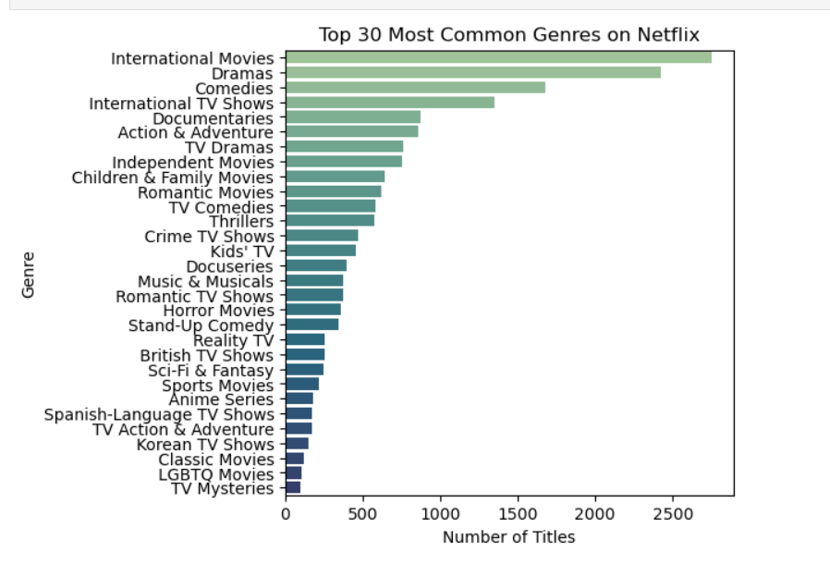
Visualizations of Netflix Content Distribution
Visualization Ideas
Bar chart: Top 30 genres
Heatmap: Missing data visualization
Line plot: Trend of content by year
Pie chart: Ratings distribution
Movies made on year basis? or
In which year highest number of the TV shows & Movies
were released? shown with Bar Graph.
Scatter Plot: Country vs Movie Duration
LINE PLOT: Content Added Over the Years: Movies vs TV Shows
BOX PLOT:Distribution of Movie Durations on Netflix
Showing all the movies that were released in year 2000.
Showing only the title of all TV shows that were released in India only.
Distribution
Bar chart: Top 30 genres.

Slide 16
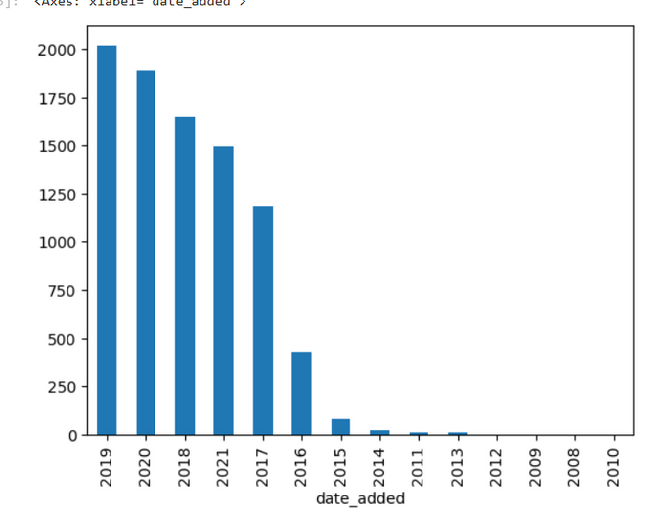
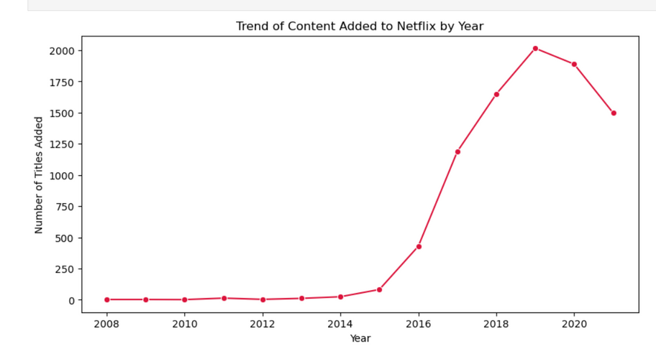
Types of Data Visualization:
Line Plot — Trend of Content by Year
In which year highest number of the TV shows & Movies were released? shown with Bar Graph.
OBSERVATION:
OBSERVATION:
Netflix content shows a sharp rise after 2015, reflecting its global expansion and focus on originals.
A slight slowdown after 2020 suggests the impact of production delays and market saturation.
The highest number of Movies and TV Shows were released in 2019, marking Netflix’s peak production phase.
This reflects the platform’s massive content expansion before the pandemic slowed global releases.

Slide 17
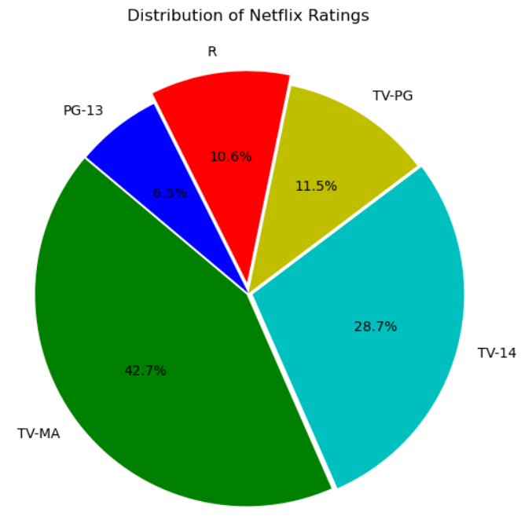
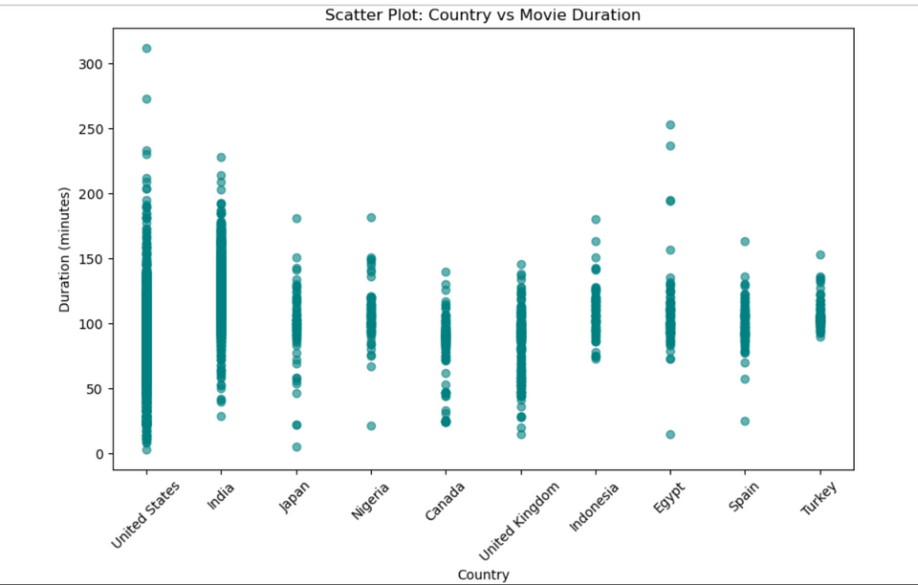
Pie Chart — Ratings Distribution
Scatter Plot: Country vs Movie Duration
OBSERVATION:
OBSERVATION:
Netflix’s library is dominated by Movies, with a smaller but growing share of TV Shows.
This shows Netflix’s focus on film content while gradually investing in series.
Movie durations vary widely across countries, with most titles averaging around 90–120 minutes.
A few countries show longer durations, indicating differences in regional storytelling styles and production trends(OUTLIERS).

Slide 18
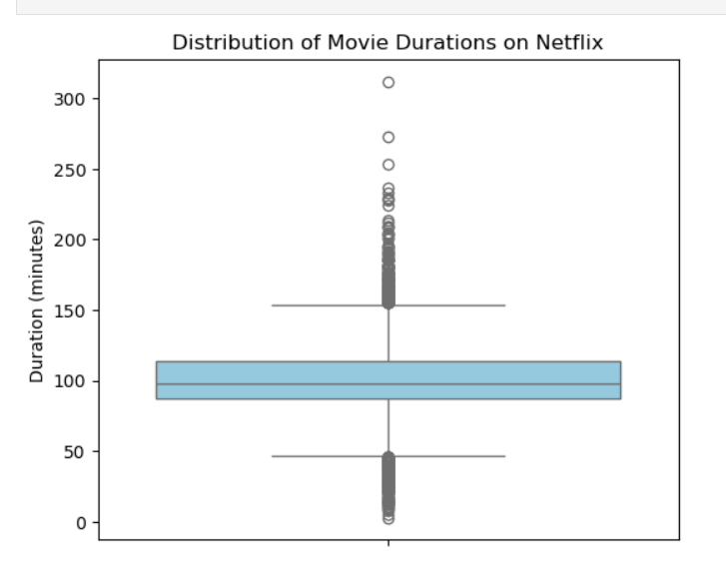
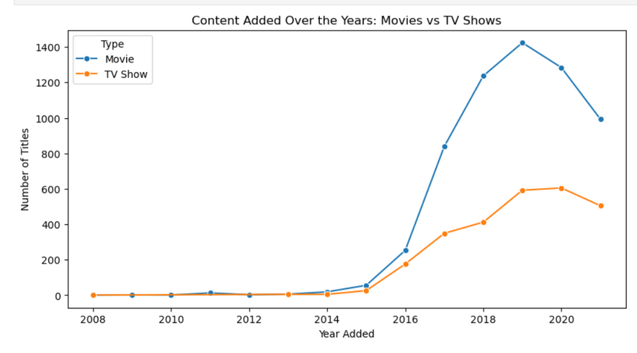
LINE PLOT: Content Added Over the Years: Movies vs TV Shows
BOX PLOT:Distribution of Movie Durations on Netflix
OBSERVATION:
OBSERVATION:
Both Movies and TV Shows added to Netflix increased steadily after 2015, showing rapid platform growth.
Movies dominated overall, but TV Shows saw a faster rise in recent years, reflecting changing viewer preferences.
Movies have a wide range of durations, while TV shows are mostly 1–2 seasons long.
Most Movies falling between 90-120 minutes of duration.Outliers have been shown clearly.

Slide 19



CONCLUSION
This exploratory data analysis of the Netflix Movies and TV Shows dataset provided valuable insights into the platform’s global content trends.
Through detailed visualization and data exploration, we identified how Netflix’s content library has evolved over the years, which countries produce the most titles, and what genres and ratings dominate the platform.
Overall, this project highlights how data-driven insights can guide strategic decisions in content production, audience targeting, and market expansion — showcasing the power of data analytics in the entertainment industry.
FUTURE SCOPE
IMPLEMENTING ML MODELS TO PREDICT CONTENT POPULARITY.
BUILDING A RECOMMENDATION ENGINE BASED ON GENRES, CAST, OR RATINGS.
PERFORMING SENTIMENT ANALYSIS ON USER REVIEWS OR TITLES.
COMPARING NETFLIX WITH COMPETITORS LIKE AMAZON PRIME OR DISNEY+.
USING TIME-SERIES FORECASTING TO PREDICT FUTURE CONTENT ADDITIONS.

